Slide 1
MERN

Slide 2
MERNG

Slide 3
MERNG
ongoDB
xpressJS
eactJS
odeJS
raphQL

Slide 4
MERNG
ongoDB
MongoDB is a source-available cross-platform document-oriented database program. Classified as a NoSQL database program, MongoDB uses JSON-like documents with optional schemas.
xpressJS
eactJS
odeJS
raphQL

Slide 5
MERNG
ongoDB
Express.js, is a back-end web application framework for Node.js,. It is designed for building web applications and APIs. It has been called the de facto standard server framework for Node.js.
xpressJS
eactJS
odeJS
raphQL

Slide 6
MERNG
ongoDB
React is a free and open-source front-end JavaScript library for building user interfaces based on UI components. React can be used as a base in the development of single-page or mobile applications.
xpressJS
eactJS
odeJS
raphQL

Slide 7
MERNG
ongoDB
xpressJS
Node.js is an open-source, cross-platform, back-end JavaScript runtime environment that runs on the V8 engine and executes JavaScript code outside a web browser
eactJS
odeJS
raphQL

Slide 8
MERNG
ongoDB
xpressJS
GraphQL is an open-source data query and manipulation language for APIs, and a runtime for fulfilling queries with existing data. GraphQL was developed internally by Facebook in 2012 before being publicly released in 2015.
eactJS
odeJS
raphQL

Slide 9
TypeScript

Slide 10
What is TypeScript ?

Slide 11
A programing language to address shortcomings of JavaScript

Slide 12


Slide 13
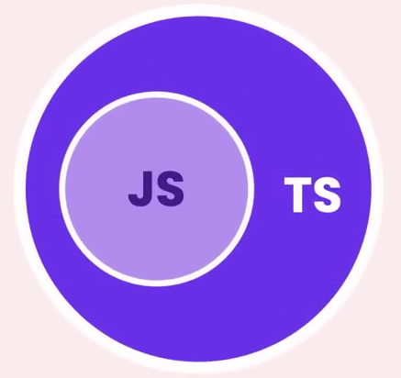

Slide 14

Benefits
Static Typing
Code Completion
Refactoring
Shorthand Notations

Slide 15

Type Checking
Code Completion
Refactoring
New Features

Slide 16
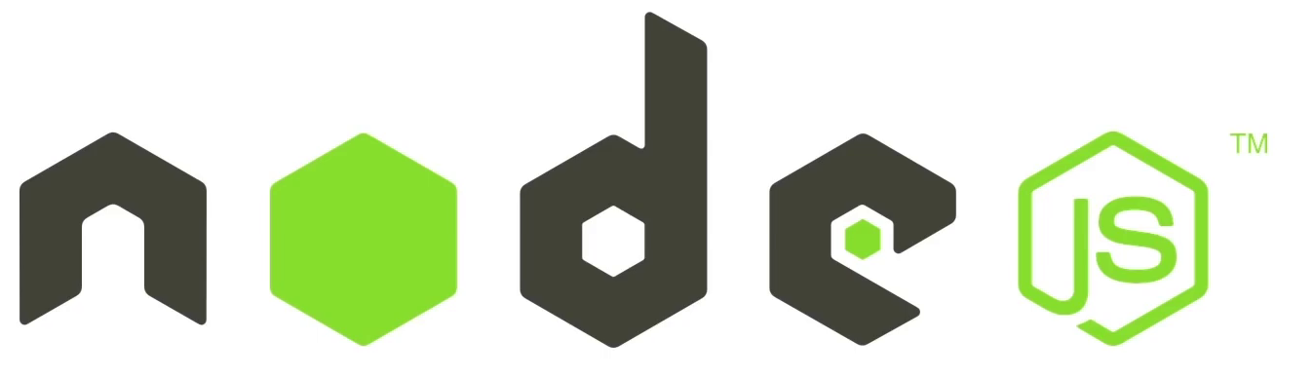

Slide 17
A runtime environment for executing JavaScript code

Slide 18
We often use Node to build back-end services

Slide 19
API

Slide 20
Application Programming Interface

Slide 21
Web App
Back-end Service
Mobile App

Slide 22
Highly-scalable, data-intensive and real-time apps

Slide 23
Great for prototyping and agile development
Superfast and highly scalable

Slide 24


Slide 25
Build twice as fast with fewer people
33% fewer line of code
NODE APP
40% fewer files
2x request/sec
35% faster response time

Slide 26
Great for prototyping and agile development
Superfast and highly scalable
JavaScript everywhere
Clear and more consistent codebase
Large ecosystem of open-source libs

Slide 27
A runtime environment for executing JavaScript code

Slide 28
Browser

Slide 29
Browser
JS
CODE
JS ENGINE
MACHINE
CODE

Slide 30



SpiderMonkey
V8
Chromium / V8

Slide 31
Browser
Runtime Environment
JavaScript Engine

Slide 32
document.getElementById(‘ ’);

Slide 33
JS in browsers
2009

Slide 34
Ryan Dahl

Slide 35
Chrome
V8

Slide 36
Chrome
V8
V8

Slide 37
Chrome
Node.exe
V8
V8

Slide 38
document.getElementById(‘ ’);

Slide 39
document.getElementById(‘ ’);

Slide 40
document.getElementById(‘ ’);
fs.readFile()
http.createServer()

Slide 41
Chrome
Node.exe
V8
V8

Slide 42

I prefer Node to C#

Slide 43
Node is NOT a programming language!

Slide 44

I prefer Node to ASP.NET

Slide 45
Node is NOT a framework!

Slide 46
A runtime environment for executing JavaScript code

Slide 47
Highly-scalable, data-intensive and real-time apps

Slide 48
How NodeJS works ??

Slide 49
Non-blocking
ASYNCHRONOUS

Slide 50
Blocking
SYNCHRONOUS

Slide 51


Request
Response
Client
Server

Slide 52



Request
Response
Client
Server
GET /
<html> ...

Slide 53

Request
Response

Slide 54
Request
Response
Request
Response
Request
Response
Request
Response

Slide 55

Server

Slide 56
Server
Server

Slide 57


Synchronous / blocking
Tyre Shop

Slide 58
Synchronous / blocking
Tyre Shop

Slide 59
Synchronous / blocking
Tyre Shop

Slide 60
Asynchronous / Non-blocking
Tyre Shop

Slide 61
Asynchronous / Non-blocking
Tyre Shop

Slide 62
Asynchronous / Non-blocking
Tyre Shop

Slide 63
Asynchronous / Non-blocking
Tyre Shop

Slide 64
Asynchronous / Non-blocking
Tyre Shop

Slide 65
Asynchronous / Non-blocking
Node JS
Event Loop
Request
Request
Feedback

Slide 66
Node applications are asynchronous by default

Slide 67
Node is ideal for I/O-intensive like real-time & data intensive apps

Slide 68
Do not use Node for is ideal for CPU-intensive apps

